Slide 1
Athletic Travel
Chrome River Pre-Approval and Expense Report Best Practices

Slide 2
Training Resources
Training Videos
University Travel Policy
Chrome River Help Center

Slide 3
Chrome River Process
Enter pre-approval prior to traveling
Travel for University
Complete expense report
Reimbursement processed

Slide 4
Prior to Travel
Prior to traveling it is important to ensure you are set up in Chrome River as a vendor and for direct deposit.
Email Procurement at purchasing@jsu.edu with your JSU ID and address
Complete Direct Deposit Authorization and send to Accounts Payable. Any changes made to the system will not appear until the following day.
Go ahead and download the Chrome River Snap app to keep digital copies of your receipt while traveling.
Be sure to enter your pre-approval with appropriate documentation prior to traveling.
Be sure to watch the Chrome River travel videos and review the University Travel Policy.

Slide 5
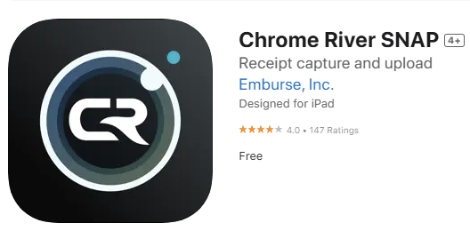
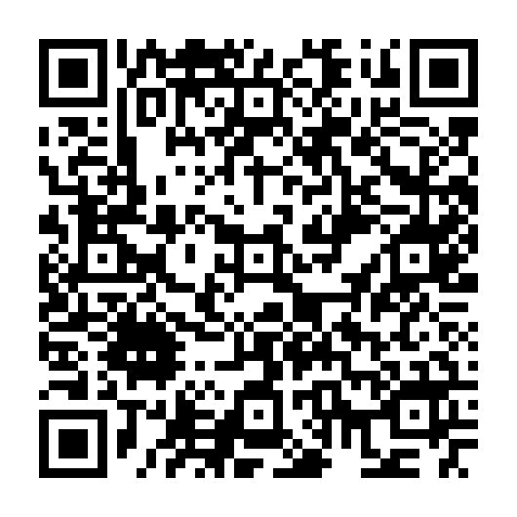
Chrome River Snap App
Scan here to download from the apple App Store

Slide 6
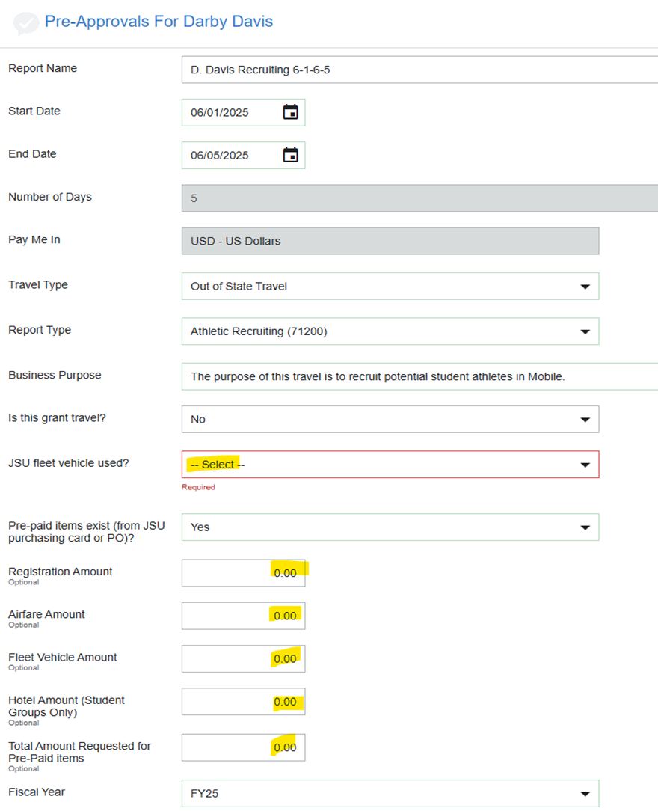
Common Pre-Approval Questions/Mistakes
Please be sure to enter the correct FOAP (Budget Line). Please keep in mind that all post season travel will go to a different org than regular season.
Make sure you indicate if you used a fleet vehicle or if you have pre-paid items on the pcard or a purchase order (PO). Common situations where you will need to indicate these include the following:
  Using rental vehicles on a PO. Football and Men’s Basketball commonly do this.
  Using a fleet vehicle van or vehicle.
  Booking your flight or hotel through Shorts Travel.
  Booking your conference registration through a pcard.
*If items are purchased on a pcard or PO, documentation should be attached to the expense report*
When you go to enter your pre-approved expenses, lines purchased on the pcard or on a PO should not be entered in estimated expenses.
Hotels for conferences should not be paid on a pcard.

Slide 7
Common Expense Report Questions/Mistakes
Please make sure to provide proper documentation for every line of your expense report including items purchased on a purchase order or pcard.
  Someone should be able to open your expense report and see the entire story of your travel based on your documentation.
Mileage should be entered based the University Address (700 Pelham Road N) or home address. The address closer to the destination should be entered.
  A specific address should always be entered not just a city.
Conference itinerary and registration should be attached to the expense report when applicable
Expense reports should be entered as soon as you return to ensure you don’t lose your receipts. Travel not entered within 60 days upon return will be taxable to the employee.

Slide 8
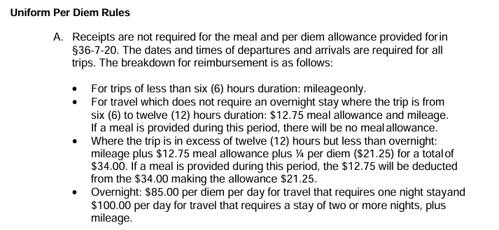
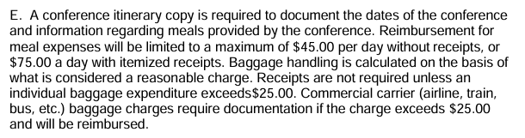
Meals
In-State Travel
-You may choose between the in-state and out of state travel meal rules.
-In state meal per diem is as follows per the Travel policy.
Out-of-State Travel
-Must be actual expenses.
-Cannot include alcohol, souvenir cup, or rounding up to charity.
-Cannot be reimbursed for meals in Calhoun County.
-Each day should be entered on one line

Slide 9
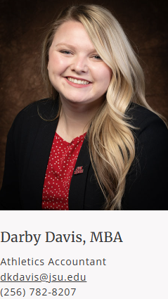
Thank you!
Please reach out if you have any further questions or would like to request additional training.

